Slide 1
Juju Service Orchestration
How to orchestrate any machine or cloud with Juju

Slide 2


Charles Butler
@lazypower

Slide 3




Introducing, The key players

Slide 4
Juju makes it magical

Slide 5
Motivation
Why Juju?

Slide 6
Rising Data Center Complexity

Slide 7
Rising Data Center Complexity

Slide 8
Rising Data Center Complexity
vm
vm
vm
vm
vm
vm
vm
vm
vm
vm
vm
vm
vm
vm
vm
vm

Slide 9
Rising Data Center Complexity
c
c
c
c
c
c
c
c
c
c
c
c
c
c
c
c
vm
vm
vm
vm
vm
vm
vm
vm
c
c
c
c
c
c
c
c
c
c
c
c
c
c
c
c
c
c
c
c
c
c
c
c
c
c
c
c
c
c
c
c
c
c
c
c
c
c
c
c
c
c
c
c
c
c
c
c
vm
vm
vm
vm
vm
vm
vm
vm
c
c
c
c
c
c
c
c
c
c
c
c
c
c
c
c
c
c
c
c
c
c
c
c
c
c
c
c
c
c
c
c

Slide 10



Complexity in Development

Slide 11
WHY?
What was our original goal?

Slide 12
EFFECTIVELY DELIVER
AND MAINTAIN
APPLICATIONS

Slide 13



Develop
Deploy
Operate
Consistent
Start and configure
Servers / services
Update servers and
applications
Shareable
Reconfigure services
Deploy and run
application
Readily Available
Orchestrate
Interactions between
services
High production
parity

Slide 14
Juju's Goal

Slide 15
Encapsulate ops knowledge in
any cloud environment: public or private

Slide 16
To provide a dynamic infrastructure
With interchangeable services

Slide 17
So you can focus on being an
expert in using the service, not
on deployment and life cycle
management.

Slide 18

Orchestration is the big picture
“Nobody is playing Nginx, or MySQL. They are playing League of Legends(tm)”
Jamie Winsor, Riot Games 2013

Slide 19
Modern architecture
is service centric.

Slide 20

Charms are more than Services

Slide 21
Whats in a charm?

Slide 22
Configuration Management

Slide 23






Language Independence

Slide 24
Operational Intelligence

Slide 25
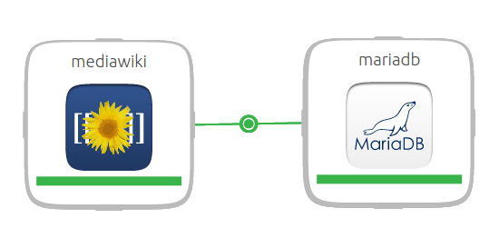
Relationships

Slide 26
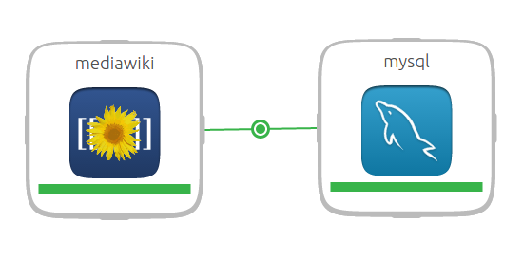
Relationships

Slide 27
Integration path
name: mediawiki
summary: "Website engine for collaborative work"
maintainer: Clint Byrum <clint@ubuntu.com>
description: |
MediaWiki is a wiki engine (a program for creating a collaboratively
edited website). It is designed to handle heavy websites containing
library-like document collections, and supports user uploads of
images/sounds, multilingual content, TOC autogeneration, ISBN links,
etc.
tags: ["applications"]
requires:
db:
interface: mysql
slave:
interface: mysql
cache:
interface: memcache
provides:
website:
interface: http

Slide 28
Requires
requires:
db:
interface: mysql
slave:
interface: mysql
cache:
interface: memcache
provides:
website:
interface: http

Slide 29
requires:
db:
interface: mysql
slave:
interface: mysql
cache:
interface: memcache
provides:
website:
interface: http

Slide 30
Provides
requires:
db:
interface: mysql
slave:
interface: mysql
cache:
interface: memcache
provides:
website:
interface: http

Slide 31
requires:
db:
interface: mysql
slave:
interface: mysql
cache:
interface: memcache
provides:
website:
interface: http

Slide 32
Interfaces are loosely typed contracts

Slide 33


Slide 34
I know how to connect to databases
that implement “MYSQL”

Slide 35

Bro, Do you even MongoDB?

Slide 36

requires:
db:
interface: mysql
slave:
interface: mysql
cache:
interface: memcache
provides:
database:
interface: mongodb
configsvr:
interface: shard
data:
interface: blk-storage
scope: container
optional: true

Slide 37
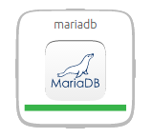
requires:
db:
interface: mysql
slave:
interface: mysql
cache:
interface: memcache
provides:
db:
interface: mysql
db-admin:
interface: mysql-root
shared-db:
interface: mysql-shared

Slide 38

requires:
db:
interface: mysql
slave:
interface: mysql
cache:
interface: memcache
provides:
db:
interface: mysql
db-admin:
interface: mysql-root
shared-db:
interface: mysql-shared

Slide 39
“You have to learn the rules of the game. And then you have to play better than anyone else.”
- Albert Einstein

Slide 40
Orchestration is Agility

Slide 41
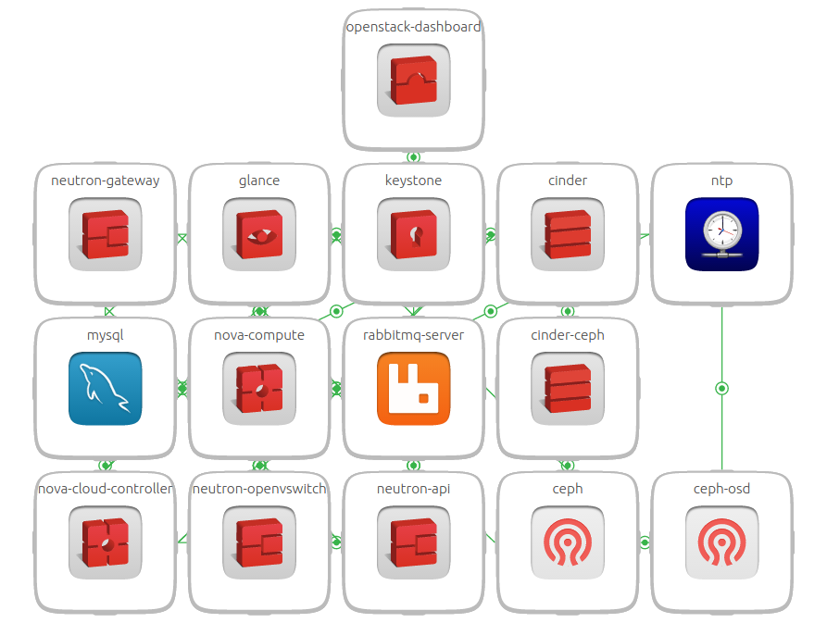

Slide 42
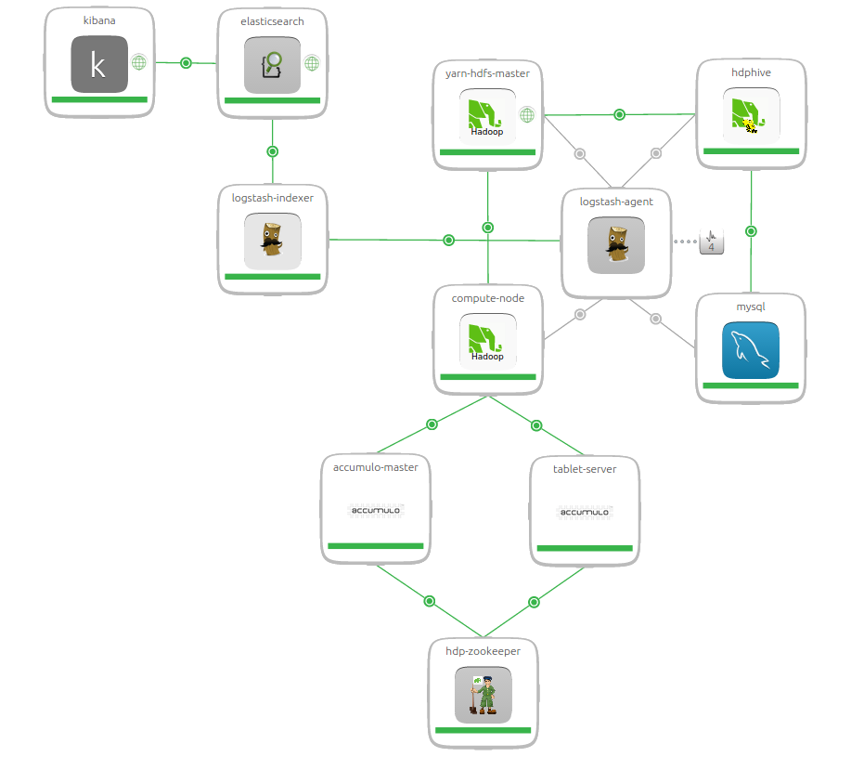

Slide 43
Executable White Paper

Slide 44
Bundle Happiness
Development
Staging
Production

Slide 45
Developers and Ops really work Together!

Slide 46
DEVELOPERS
OPERATORS
Deploy Applications
Production Parity
Ship Infrastructure Fragments
ments
Define core infrastructure
Audit for Security
Operate at scale
ments

Slide 47
DEVELOPERS
OPERATORS
Work with only their concerns
Modify entire bundle
Move services between clouds

Slide 48
C
C
C
C
C
C
Decompose infra
C
C
C
C
C
C
DEV
VM
VM
VM
Delegate concerns
IAAS (OpenStack, Ubuntu)
Deploy Happiness
OPS
PHYSICAL

Slide 49


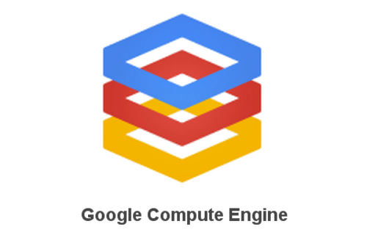



Where can I use it?

Slide 50

Using the manual provider you can deploy
on any cloud, public or private
With Ubuntu MAAS you can even orchestrate
bare metal!

Slide 51
Tooling to facilitate your creativity

Slide 52
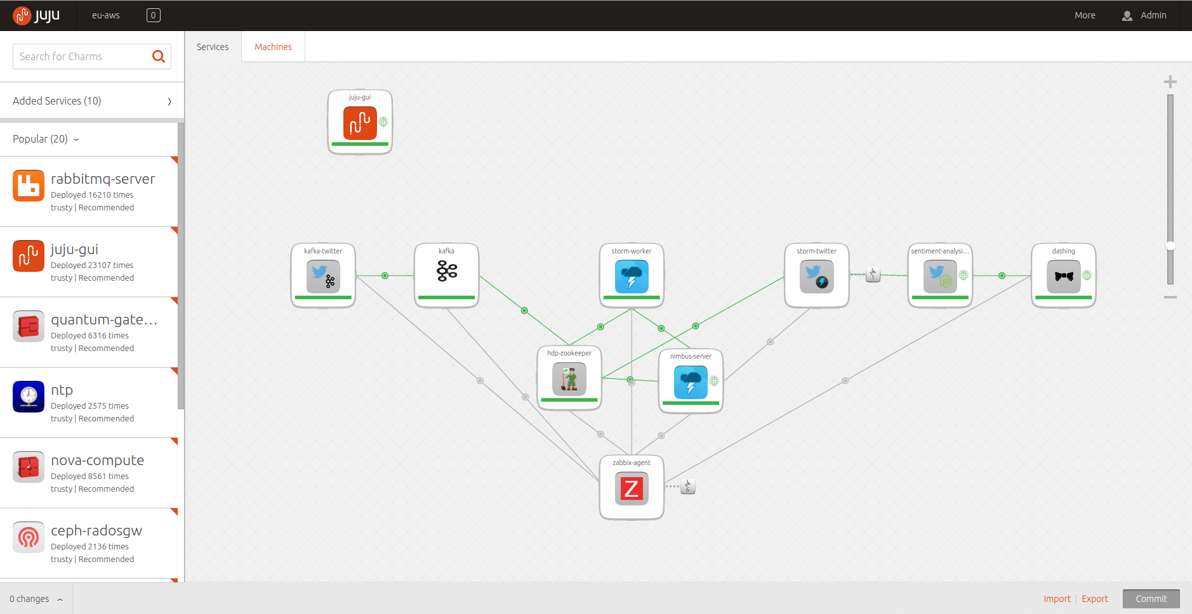
Juju GUI

Slide 53
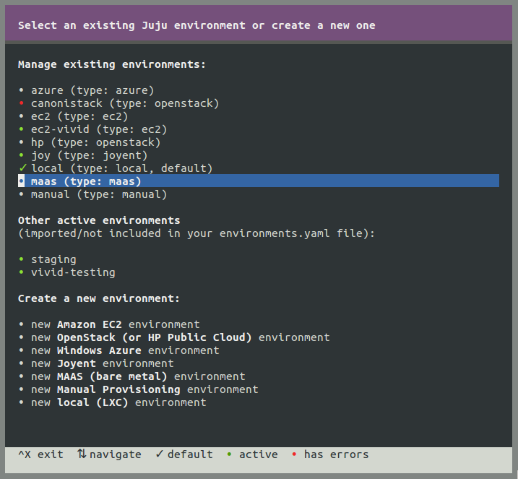
Juju Quickstart

Slide 54
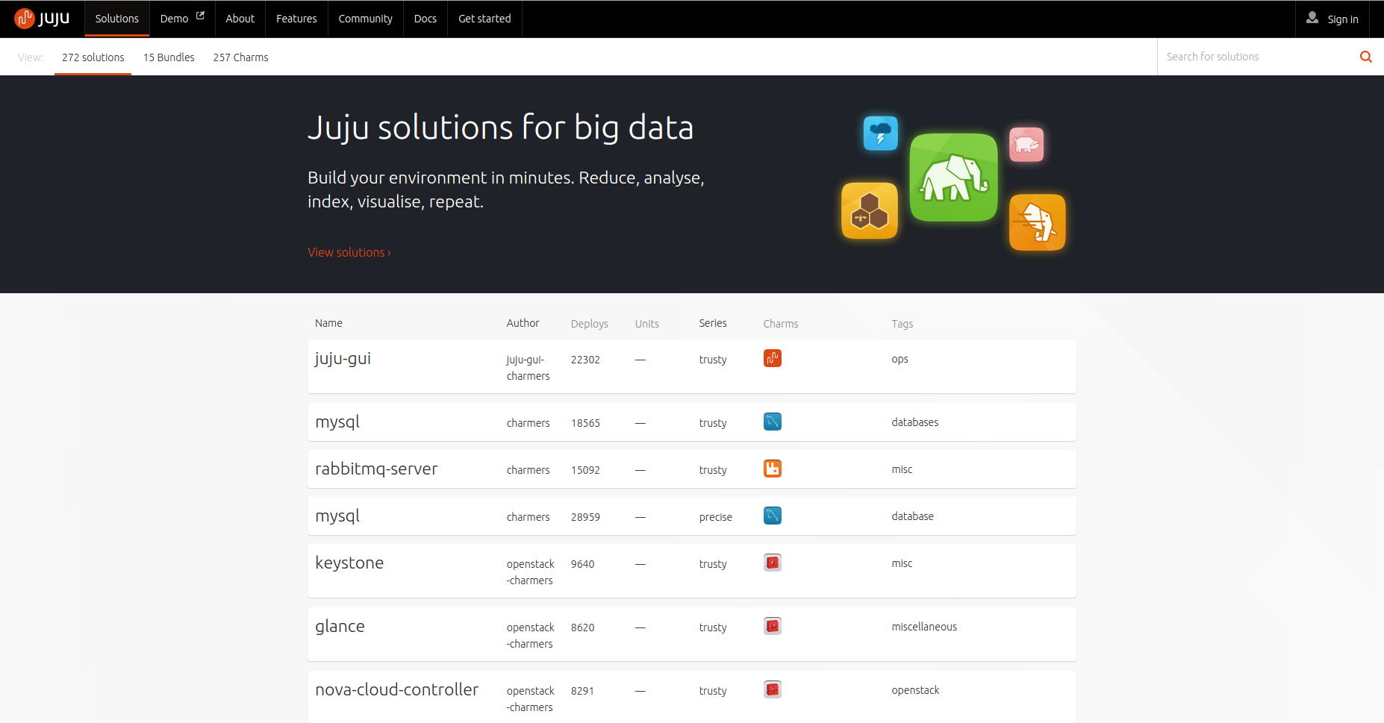
The Charm Store

Slide 55
Charles Butler
@lazypower
jujucharms.com
irc.freenode.net #juju
juju@lists.ubuntu.com

